Slide 1
Home security system

Slide 2
Problem statemement
Currently there are many issues about burglary leading to loss of the property of the majority. The system is aimed at reducing all the issues as it will involve alerting the registered household members once someone approaches their specific household. Once the SMS alert is sent any it happens there is no one responded that they are the one at the gate then the buzzer should produce sound.

Slide 3
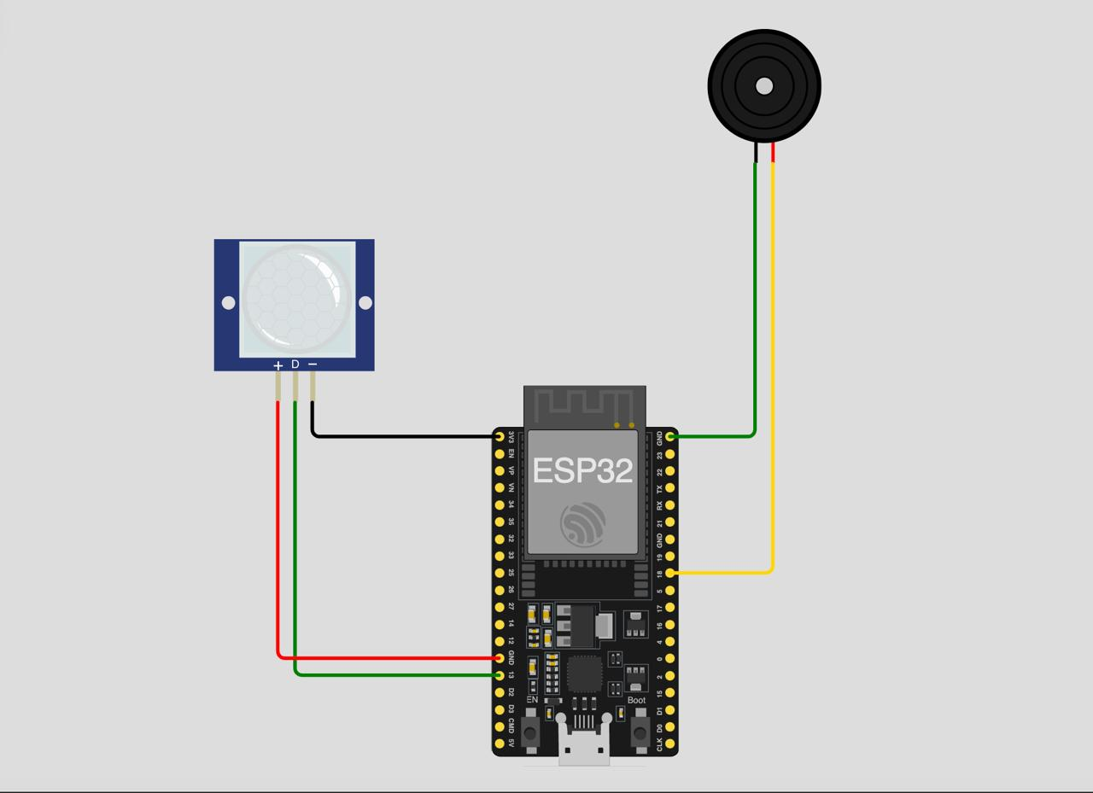

Slide 4
Objectives of home security
System to detect objects approach to the household
System to send an alert sms once someone approaches the household
Buzzes once the object approaches

Slide 5
Importance of the system
Improves security
Enables remote control
Ensures peace of mind

